Slide 1

THRILL WP 3.4
Udo Eisenbarth, Yannik Zobus

Slide 2

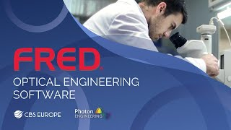




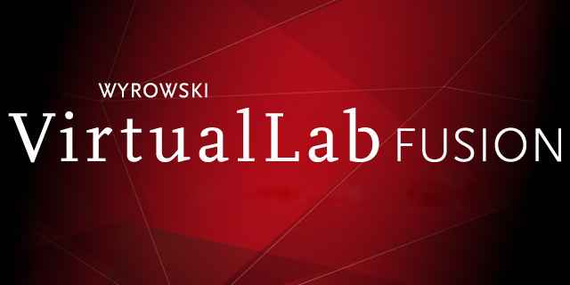
Yet another optics simulation software ?
sdf

Slide 3
Simulation platform approach
sdf

Slide 4
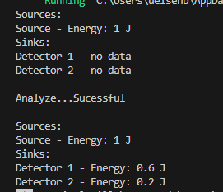
Simple setup (filter system)
Input energy: 1J
60/40 beam splitter
50% filter

Slide 5
Simulating double-pass systems
Solution: „Reference nodes“
Does not work!
(would form a loop)
linked elements
(inverted)

Slide 6
Example: Michaelson Interferometer

Slide 7
OPOSSUM ecosystem
MaterialDB

Slide 8
Project status
Project plan
Optical model concept worked out
OPOSSUM v0.2.0
technical concept preview
simple command line interface (CLI)
implementation of first simple nodes (source, detector, filter, beam splitter, etc..)
implementation of group & reference nodes
energy analyzer

Slide 9
Outlook
planned milestones:
v0.3: implementation of basic ray tracing (wavelength and polarization dependent)
v0.4: inclusion of first external code (Python module: SHG simulation by M. Malki)

